Slide 1


September 2024
Unlocking the Power of DSA with CPP
A Journey Through Summer Training at Cipher Schools
Nitin Kumar Singh
12223111

Slide 2

Table of Contents
1
Welcome to the World of DSA
5
Technologies Explored in My Training
2
Introduction to Cipher Schools
6
Why I Chose DSA with CPP
3
Understanding Data Structures
7
My Summer Training Project
4
The Importance of Algorithms
8
Key Takeaways from My Internship

Slide 3
9
Conclusion and Future Aspirations
10
Thank You!

Slide 4
Welcome to the World of DSA
Data Structures and Algorithms (DSA) are fundamental concepts in computer science that enable efficient data management.
In this presentation, we will explore the insights gained during my six-week summer internship at Cipher Schools.
From understanding the basics to applying DSA in real-world scenarios, this journey was enlightening and transformative.
Join me as we dive deep into what DSA is and how it shapes the world of technology.
Let's embark on this educational expedition together!

Slide 5
Introduction to Cipher Schools
Cipher Schools is a premier educational video-streaming platform based in India, tailored for both content creators and eager learners.
With an array of features including a learning management system and online tutoring, it enhances learning experiences significantly.
Throughout my internship, I experienced first-hand how Cipher Schools fosters a culture of innovation and excellence in education.
Their mission is to make advanced learning accessible and enjoyable for everyone.
Explore more at their official website.

Slide 6
Understanding Data Structures
Data Structures are essential for organizing and storing data effectively, enabling various operations like insertion and deletion.
They play a crucial role in optimizing performance for tasks such as searching and sorting data efficiently.
By utilizing different data structures, we can improve the capabilities of software applications significantly.
Gaining proficiency in DSA can lead to a deeper understanding of algorithmic complexities and performance enhancement.
It’s all about managing data smartly!

Slide 7
Overview of DSA
DSA(Data Structures & Algorithms) refers to the systematic way of organizing and data to enable efficient computation and problem-solving.
Overview of C++
C++ is a powerful, high-performance programming language developed by Bjarne Stroustrup in 1985 as an extension of the C language. It supports both procedural programming (like C) and object-oriented programming (OOP). This combination allows C++ to be used for system software, game development, applications requiring high performance, and large-scale applications like databases and cloud services.

Slide 8
Arrays
An array is a collection of elements (values or variables), each identified by an index or key, stored in contiguous memory locations.
Key Characteristics:
Fixed size, determined at the time of declaration.
Homogeneous data elements (same data type).
Types:
1D Arrays (Single Dimension)
2D Arrays (Two Dimensional like a Matrix)
Time Complexity:
Accessing the Element in an Array – O(1)
Inserting the Element in an Array – O(n)
Deleting the Element in an Array – O(n)

Slide 9
Linked Lists
A linked list is a linear data structure where elements (nodes) are not stored in contiguous memory locations.
Types of Linked Lists:
Singly Linked List – Each node points to the next node in one direction.
Doubly Linked List – Each node points to both the next and previous nodes.
Circular Linked List – The last node points back to the first node, forming a loop.
Key points:
Dynamic size (flexible memory allocation).
Efficient insertions and deletions at the beginning or middle.
No direct access to elements (sequential access required).
Time Complexity:
Accessing Element – O(n) Traversing from the head node to the desired position is required.
Inserting Element – O(1) Insertion at the head , O(n) Inserting at a specific position
Deleting Element – O(1) Deleting the head node , O(n) Deleting from a specific position

Slide 10
Stack
A stack is a linear data structure that follows the LIFO (Last In, First Out) principle
last added element will be removed first
Key Points:
Simple and fast operations with constant time complexity.
Limited access: Only the top element can be accessed directly.
Time Compexity:
Push – O(1) Add an element to the top of the stack.
Pop – O(1) Remove the top element from the stack.
isEmpty – O(1) Check if the stack is empty.

Slide 11
Queues
A queue is a linear data structure that follows the FIFO (First In, First Out) principle.
The first element added to the queue is the first one to be removed.
Key Points:
Efficient for real-time processing and managing resources in order.
Limited access: Only the front and rear elements can be accessed directly.
Types of Queues:
Simple Queue (Basic FIFO structure) , Circular Queue (The last position is connected to the first, forming a loop)
Prority Queue (Elements are dequeued based on priority) , Dequeue (Insertion & Deletion allowed on both sides)
Time Complexity:
Enqueue – O(1) Adding element at end of the Queue.
Dequeue – O(1) Removing element from front of the Queue.
isEmpty – O(1) Check if the Queue is empty.

Slide 12
Trees
In C++, trees are implemented using classes where each node has pointers to its children (and optionally its parent). The most common type is the binary tree, where each node has at most two children
The top node is called the root, and the nodes with no children are leaves.
Key terms:
Root: The topmost node
Parent/Child: Directly connected nodes in the hierarchy.
Leaf Node: A node with no children.
Subtree: A tree formed by any node and its descendants.
Depth/Height: Distance from the root node or to the furthest leaf.
Time Complexity:
Insertion – O(log n) for balanced trees (e.g., BST, AVL)
Deletion – O(log n) for balanced trees
Traversal – O(n) Methods like In-order, Pre-order, Post-order, and Level-order

Slide 13
Types of Trees
Binary Tree: Each node has at most two children (left and right).
Binary Search Tree (BST): A binary tree where the left child contains smaller values and right child contains larger values.
AVL Tree: A self-balancing binary search tree.
Heap: A tree-based data structure where the parent is either greater (max-heap) or smaller (min-heap) than its children.

Slide 14
Graphs
A graph is a non-linear data structure consisting of vertices (or nodes) connected by edges. Graphs can represent relationships between entities in a network.
Key Terms:
Vertex (Node): A fundamental unit in a graph.
Edge: A connection between two vertices.
Directed Graph: Edges have a direction (from one vertex to another).
Undirected Graph: Edges have no direction.
Weighted Graph: Each edge has a weight (or cost) associated with it.
Degree: The number of edges connected to a vertex.
Path: A sequence of vertices connected by edges.
Types of Graphs:
Directed Graph (Digraph): Edges point from one vertex to another.
Undirected Graph: Edges have no direction.
Weighted Graph: Edges carry weights
Connected Graph: There's a path between every pair of vertice
Acyclic Graph: No cycles in the graph (e.g., Directed Acyclic Graph - DAG)

Slide 15
Sorting Algorithms: Techniques to arrange data in a specific order, including
Bubble sort
Selection sort
Insertion sort
Quick sort
Merge sort
Searching Algorithms: Methods to find specific data within a structure, including
Binary search (required sorted data)
Linear search
Graph Algorithms: : Techniques for traversing or analyzing graphs, such as
Depth first search
Breadth first search
Dijkstra’s algorithm for shortest path

Slide 16
Types of Time Complexity
Big O: Big O notation is used to describe the worst-case time or space complexity of an algorithm, measuring its efficiency as input size grows.
Big Omega: Big Omega (Ω) notation is used to describe the best-case time or space complexity of an algorithm, representing the lower bound of its performance.
Big Theta: Big Theta (Θ) notation is used to describe the exact asymptotic behavior of an algorithm, providing both the upper and lower bounds of its time or space complexity

Slide 17
The Importance of Algorithms
Algorithms are step-by-step procedures or sets of rules that guide problem-solving on data.
Mastering algorithms is vital for developing efficient solutions in computing, ensuring that we can tackle complex problems effectively.
During my training, I learned how algorithms work hand in hand with data structures to achieve optimal results.
Understanding algorithms enhances critical thinking and problem-solving skills in programming.
They are the backbone of every successful software application.

Slide 18
Technologies Explored in My Training
Throughout my summer training, I engaged deeply with various technologies related to DSA and C++ programming.
I learned about linked lists, trees, graphs, and their implementations in CPP, enriching my technical skills.
The hands-on experience was invaluable, promoting both theoretical understanding and practical application.
With C++, I was able to implement complex algorithms and improve my coding proficiency significantly.
This training prepared me for real-world software challenges.

Slide 19
Why I Chose DSA with CPP
I chose to specialize in DSA with C++ because of its robust features and versatility in application development.
C++ offers high performance crucial for implementing complex data structures and algorithms efficiently.
Understanding DSA helps in writing better code, refining coding techniques, and improving overall problem-solving ability.
The blend of DSA and C++ opens doors to numerous opportunities in the tech industry.
It's an essential skill for aspiring computer scientists.

Slide 20
My Summer Training Project
The highlight of my training was a mini project that applied DSA concepts in a real-world scenario.
This project reinforced my understanding of data structures and their functionalities in building efficient applications.
I was able to collaborate with peers, enhancing teamwork skills while integrating various DSA principles into a cohesive project.
This hands-on experience was pivotal in solidifying my learning outcomes throughout the internship.
Stay tuned for more insights on our project outcomes!

Slide 21
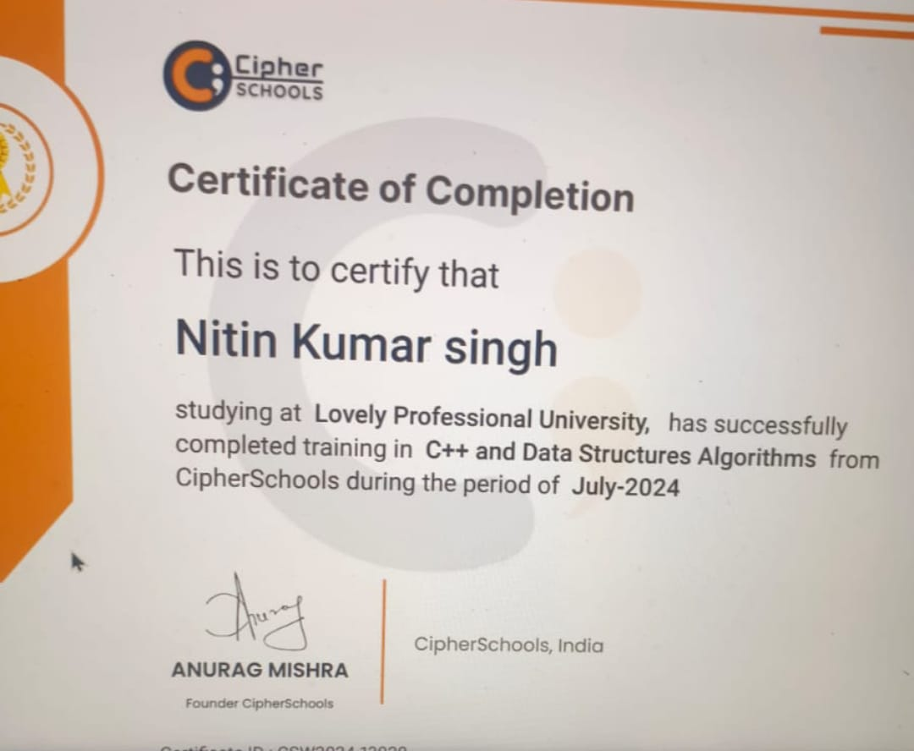
My Summer Training Certificate

Slide 22
Key Takeaways from My Internship
This internship was not just about learning DSA; it was about applying that knowledge practically.
I learned the significance of problem-solving, creativity, and analytical thinking in the field of computer science.
Furthermore, the experience honed my coding skills and introduced me to collaborative project environments.
The guidance from mentors at Cipher Schools inspired me to pursue continuous learning and innovation.
These takeaways are invaluable as I advance in my career.

Slide 23
Conclusion and Future Aspirations
In conclusion, my summer training at Cipher Schools was an enriching experience that broadened my horizons in DSA and programming.
It equipped me with essential skills and knowledge that I will carry forward in my academic and professional journey.
I aspire to contribute to the tech industry by leveraging DSA knowledge to create impactful solutions.
This journey has inspired me to continue learning and embracing challenges in computer science.
The future is bright, and I am excited about what lies ahead!

Slide 24
Thank You!
Thank you for taking the time to engage with my presentation on my summer internship at Cipher Schools.
I appreciate your attention and hope you found the insights valuable.
Feel free to reach out if you have any questions or would like to discuss further.
Let's connect and inspire each other to achieve greatness in the tech world!
Wishing you all success in your future endeavors!

